Slide 1
Language Enhancements and LINQ
Daniel Moth
Developer & Platform Group
Microsoft Ltd
daniel.moth@microsoft.com
http://www.danielmoth.com/Blog

Slide 2
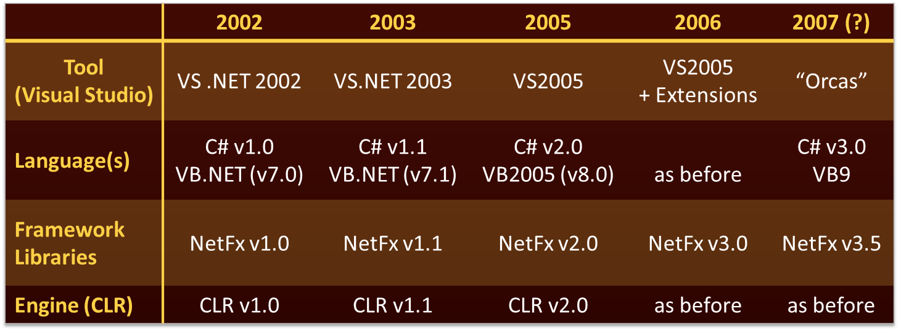
.NET Through The Ages

Slide 3

AGENDA
C# v3 Goals
VB v9 Goals
Introducing the goal: LINQ
Rest of the talk
  Language features that make LINQ work

Slide 4

The Evolution of C#
C# 3.0
Language Integrated Query
C# 2.0
Generics
C# 1.0
Components on a Managed Runtime

Slide 5
C# 3.0 Design Goals
Integrate objects, relational data, and XML
And
  Increase conciseness of language
  Add functional programming constructs
  Don’t tie language to specific APIs
  Remain 100% backwards compatible

Slide 6
Visual Basic 9.0
Simplify querying data
  Integrate query and transform operations
  Unify query of object, relational, and XML data
Simplify working with XML
  Impose structure on XML w/no schema
  Produce XML documents quickly
  Access XML members easily

Slide 7
Simplify querying
Notes:
using System;
using System.Collections.Generic;
namespace TheGoal
{
public class Person
{
public string Name;
public int Age;
public bool IsMarried;
public static List<Person> GetPeople()
{
// create 3 Person objects
Person p1 = new Person();
p1.Age = 17;
p1.Name = "P1";
p1.IsMarried = false;
Person p2 = new Person();
p2.Age = 18;
p2.Name = "P2";
p2.IsMarried = true;
Person p3 = new Person();
p3.Age = 19;
p3.Name = "P3";
p3.IsMarried = true;
// create and populate colleciton
List<Person> people = new List<Person>();
people.Add(p1);
people.Add(p2);
people.Add(p3);
return people;
}
public override string ToString()
{
return
this.Name + ", "
+ this.Age.ToString() + ", "
+ this.IsMarried.ToString();
}
}
}
--
public class TempType
{
public string Name;
public int Age;
public override string ToString()
{
return "Name=" + this.Name + ", Age =" + this.Age;
}
}
--
class Program
{
static void Main(string[] args)
{
List<TempType> //Person>
results = //Person.GetPeople();
new List<TempType>(); //Person>();
foreach (Person p in Person.GetPeople())
{
if (p.IsMarried)
{
TempType tmp = new TempType();
tmp.Name = p.Name;
tmp.Age = p.Age;
results.Add(tmp);//p);
}
}
// use results
foreach (Person p in results)
{
// do something real with p
//p.
Console.WriteLine(p.ToString());
}
Console.ReadLine();
}

Slide 8
from c in Customers
where c.City == "Hove"
select new { c.Name, c.Address };
From c In Customers _
Where c.City = "Hove" _
Select c.Name, c.Address

Slide 9
The Syntax
Starts with from
Zero or more from, join, let, where, or orderby
from id in source
{ from id in source |
join id in source on expr equals expr [ into id ] |
let id = expr |
where condition |
orderby ordering, ordering, … }
select expr | group expr by key
[ into id query ]
Ends with
select or group by
Optional into continuation

Slide 10




Language INtegrated Query (LINQ)
VB
C#
Others…
.NET Language-Integrated Query
LINQ enabled data sources
LINQ enabled ADO.NET
LINQ
To Objects
LINQ
To DataSets
LINQ
To SQL
LINQ
To Entities
LINQ
To XML
<book>
<title/>
<author/>
<price/>
</book>
Objects
Relational
XML

Slide 11
The rest of this Talk
Language Enhancements
  Local Variable Type Inference
  Object Initialisers
  Anonymous Types
  Lambda Expressions
  Extension Methods
+ Query Expressions
= LINQ ☺

Slide 12
Local Variable Type Inference
Notes:
// make it up
var o = new Person();
object o = new Person();

Slide 13




Local Variable Type Inference (c#)
int i = 666;
string s = "Goodbye";
double d = 3.14;
int[] numbers = new int[] {1, 2, 3};
Dictionary<int,Order> orders = new Dictionary<int,Order>();
var i = 666;
var s = "Goodbye";
var d = 3.14;
var numbers = new int[] {1, 2, 3};
var orders = new Dictionary<int,Order>();
“The type on the right hand side”

Slide 14

Type Inference (VB)
Variable type inferred from initialiser
Integer
String
Double
Dim x = 666
Dim s = “Bye"
Dim d = 3.14
Dim numbers = New Integer() {1, 2, 3}
Dim orders = new Dictionary(Of Integer, Order)()
Notes:
©2005 Microsoft Corporation. All rights reserved.
This presentation is for informational purposes only. Microsoft makes no warranties, express or implied, in this summary.
Types are inferred from the right hand side if Option Infer is On… (Which it is for new projects)

Slide 15
Object Initialisers
Notes:
Person p4 = new Person() { Name = "P4", Age = 20, IsMarried = true };

Slide 16




Object Initialisers (c#)
public class Point
{
private int x, y;
public int X { get { return x; } set { x = value; } }
public int Y { get { return y; } set { y = value; } }
}
Field or property assignments
Point a = new Point { X = 0, Y = 1 };
Point a = new Point();
a.X = 0;
a.Y = 1;

Slide 17




Object Initialisers (VB)
Public Class Point
Private xx As Integer
Public Property X() As Integer
Get
Return xx
End Get
Set(ByVal value As Integer)
xx = value
End Set
End Property
Public Y As Integer ‘or property
End Class
Field or property assignments
Dim a As Point = New Point With { .X = 0, .Y = 1 }
Dim a As Point = New Point()
a.X = 0
a.Y = 1

Slide 18
Anonymous types
Notes:
var results = new[]
{
new { Name ="P1", Age = 5},
new { Name ="P2", Age = 6}
};

Slide 19

Anonymous Types (c#)
class XXX
{
public string Name;
public int Age;
}
XXX
var o = new { Name = “Jenny”, Age = 31 };

Slide 20


Anonymous Types (VB)
Class XXX
Public Name As String
Public Age As Integer
End Class
XXX
Dim o As Object = New With { .Name = “Jenny”, .Age = 31 }
Dim o = New With { .Name = “Jenny”, .Age = 31 }

Slide 21
Lambda Expressions
Notes:
delegate bool F(Person a);
static void Main()
{
F f =
// new F(MyMethod)
// MyMethod
/*delegate(Person p)
// {
// return p.IsMarried;
} */
// delegate(Person p){return p.IsMarried;}
// (Person p) => { return p.IsMarried; }
p => p.IsMarried
;
SomeOtherMethod(f);
Console.ReadLine();
}
//static bool MyMethod(Person p)
//{
// return p.IsMarried;
//}
private static void SomeOtherMethod(F f)
{
// some logic
bool b = f(new Person{Age = 21, IsMarried = true});
// more logic
Console.WriteLine(b.ToString());
}

Slide 22

Lambda Expressions
public delegate bool Predicate<T>(T obj);
public class List<T>
{
public List<T> FindAll(Predicate<T> test) {
List<T> result = new List<T>();
foreach (T item in this)
if (test(item)) result.Add(item);
return result;
}
…
}

Slide 23

Lambda Expressions (c#)
public class MyClass
{
public static void Main() {
List<Customer> customers = GetCustomerList();
List<Customer> locals =
customers.FindAll(
new Predicate<Customer>(CityEqualsHove)
);
}
static bool CityEqualsHove(Customer c) {
return c.City == "Hove";
}
}

Slide 24

Lambda Expressions (c#)
public class MyClass
{
public static void Main() {
List<Customer> customers = GetCustomerList();
List<Customer> locals =
customers.FindAll(
delegate(Customer c) { return c.City == "Hove"; }
);
}
}

Slide 25
Lambda Expressions (c#)
public class MyClass
{
public static void Main() {
List<Customer> customers = GetCustomerList();
List<Customer> locals =
customers.FindAll(
(Customer c) => {return c.City == "Hove";}
);
}
}
Lambda expression

Slide 26
Lambda Expressions (c#)
public class MyClass
{
public static void Main() {
List<Customer> customers = GetCustomerList();
List<Customer> locals =
customers.FindAll(
c => c.City == "Hove"
);
}
}
Lambda expression

Slide 27

Lambda Expressions (c#)
public class MyClass
{
public static void Main() {
List<Customer> customers = GetCustomerList();
List<Customer> locals =
customers.FindAll(c => c.City == "Hove");
}
}
Lambda expression

Slide 28


Lambda Expressions (VB)
Public Function GetTheLocals() As List(Of Customer)
Dim customers As List(Of Customer) = GetCustomerList()
return customers.FindAll(Function(c) c.City = "Hove")
End Function
Public Function GetTheLocals() As List(Of Customer)
Dim customers As List(Of Customer) = GetCustomerList()
return customers.FindAll(AddressOf CityEqualsHove)
End Function
Function CityEqualsHove(ByVal c As Customer) As Boolean
Return c.City = "Hove"
End Function
Lambda expression

Slide 29
Extension Methods
Notes:
static bool MyMethod(Person p)
{
//return MyExtensions.IsOver15(p);
return p.IsOver15();
}
public static class MyExtensions
{
//[System.Runtime.CompilerServices.Extension()]
public static bool IsOver15(this Person p)
{
return p.Age > 15;
}
}

Slide 30



Extension Methods (c#)
Extension method
namespace MyStuff
{
public static class Extensions
{
public static string Concatenate(this IEnumerable<string> strings,
string separator) {…}
}
}
Brings extensions into scope
using MyStuff;
string[] names = new string[] { "Jenny", "Daniel", "Rita" };
string s = names.Concatenate(", ");
obj.Foo(x, y)
↓
XXX.Foo(obj, x, y)
IntelliSense!

Slide 31




Extension Methods (VB)
Extend existing types with new methods
Namespace ArrayExtensions
<Extension()> _
Module IntArrExtensions
<Extension()> _
Function Sort(i As Integer()) As Integer()
…
End Function
<Extension()> _
Sub ReverseInPlace(ByRef i As Integer())
…
End Property
End Extension
End Namespace
obj.Foo(x, y)
↓
XXX.Foo(obj, x, y)
Imports ArrayExtensions
Dim values() As Integer = {5, 4, 2, 1, 3}
Console.WriteLine(IntegerArrExtensions.ReverseInPlace( _
IntegerArrExtensions.Sort(values))
Dim values() As Integer = GetValues()
Console.WriteLine(values.Sort().ReverseInPlace())

Slide 32
Bringing it all together and introducing the System.Linq namespace
Notes:
// execute query
var results =
Person.GetPeople()
.Where(p => p.IsMarried)
.Select(p => new { Name = p.Name, Age = p.Age });
--
using System;
using System.Collections.Generic;
namespace MyLinq
{
public delegate TRes Func<TSrc, TRes>(TSrc src);
public static class Enumerable
{
public static IEnumerable<TSrc> Where<TSrc>(this
IEnumerable<TSrc> source, Func<TSrc, bool> predicate)
{
List<TSrc> res = new List<TSrc>();
foreach (TSrc s in source)
{
if (predicate(s))
{
res.Add(s);
}
}
return res;
}
public static IEnumerable<TRes> Select<TSrc, TRes>(this
IEnumerable<TSrc> source, Func<TSrc, TRes> selector)
{
List<TRes> res = new List<TRes>();
foreach (TSrc s in source)
{
res.Add(selector(s));
}
return res;
}
}
}

Slide 33

Query Expressions (c#)
Queries translate to method invocations
  Where, Join, OrderBy, Select, GroupBy, …
from c in customers
where c.City == "Hove"
select new { c.Name, c.Phone };
customers
.Where(c => c.City == "Hove")
.Select(c => new { c.Name, c.Phone });

Slide 34









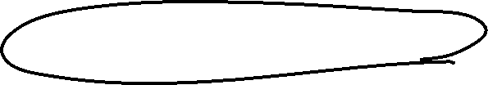


Query Expressions (VB)
Dim highThreadProcs = _
From proc In Process.GetProcesses _
Where proc.Threads.Count > 10 _
Select proc.ProcessName, proc.Threads.Count
Dim highThreadProcs = Process.GetProcesses(). _
Where(Function(proc As Process) proc.Threads.Count > 10). _
Select (Function(proc As Process) _
New With {.ProcessName = proc.ProcessName _
.Count = proc.Threads.Count)
Function _Filter1(proc As Process) As Boolean
Return proc.Threads.Count > 10
End Function
Function _Projection1(proc As Process) As <Anonymous Type>
Dim projection As New <AnonymousType>
projection.ProcessName = proc.ProcessName
projection.Count = proc.Threads.Count
Return projection
End Function

Slide 35
Query Expressions
Starts with from
Zero or more from, join, let, where, or orderby
from id in source
{ from id in source |
join id in source on expr equals expr [ into id ] |
let id = expr |
where condition |
orderby ordering, ordering, … }
select expr | group expr by key
[ into id query ]
Ends with
select or group by
Optional into continuation

Slide 36
Query Expressions
Project | Select <expr>
Filter | Where <expr>, Distinct
Test | Any(<expr>), All(<expr>)
Join | <expr> Join <expr> On <expr> Equals <expr>
Group | Group By <expr>, <expr> Into <expr>, <expr> Group Join <decl> On <expr> Equals <expr> Into <expr>
Aggregate | Count(<expr>), Sum(<expr>), Min(<expr>), Max(<expr>), Avg(<expr>)
Partition | Skip [ While ] <expr>, Take [ While ] <expr>
Set | Union, Intersect, Except
Order | Order By <expr>, <expr> [ Ascending | Descending ]
Notes:
© 2005 Microsoft Corporation. All rights reserved.
This presentation is for informational purposes only. Microsoft makes no warranties, express or implied, in this summary.
Group Join is essentially “Left outer join” for hierarchical data

Slide 37
More Examples of LINQ queries
Notes:
processes and process collection

Slide 38

C# 3.0 Language Innovations
Query expressions
var contacts =
from c in customers
where c.City == "Hove"
select new { c.Name, c.Phone };
Local variable type inference
Lambda expressions
var contacts =
customers
.Where(c => c.City == "Hove")
.Select(c => new { c.Name, c.Phone });
Extension methods
Anonymous types
Object initializers

Slide 39
VB 9.0 Language Innovations
Query expressions
Dim contacts =
From c In customers _
Where c.City = "Hove" _
Select c.Name, c.Phone
Local variable type inference
Lambda expressions
Dim contacts = _
customers _
.Where(Function(c) c.City = "Hove") _
.Select(Function(c) New With { c.Name, c.Phone })
Extension methods
Anonymous types
Object initializers

Slide 40
BEFORE THE SUMMARY,
ONE LAST FEATURE...

Slide 41

Expression Trees (VB)
System.Linq.Expressions.Expression(Of T)
where T is a delegate type
Dim f As Predicate(Of Customer) = Function (c) c.City = "Hove"
Dim e As Expression(Of Predicate(Of Customer)) = Function (c) c.City = "Hove"
Dim e As Expression(Of Predicate(Of Customer)) = _
New Expression(Of Predicate(Of Customer))(
New BinaryExpression(ExpressionType.EQ,
New PropertyExpression(
New ParameterExpression(0),
GetType(Customer).GetProperty("City")
),
New ConstantExpression("Hove")
)
)

Slide 42


Expression Trees (c#)
public delegate bool Predicate<T>(T item);
Expression<Predicate<Customer>> test = c => c.City == "Hove";
ParameterExpression c =
Expression.Parameter(typeof(Customer), "c");
Expression expr =
Expression.Equal(
Expression.Property(c, typeof(Customer).GetProperty("City")),
Expression.Constant("Hove")
);
Expression<Predicate<Customer>> test =
Expression.Lambda<Predicate<Customer>>(expr, c);

Slide 43

Expression Trees (c#)
public delegate bool Predicate<T>(T item);
Predicate<Customer> test = c => c.City == "Hove";
Predicate<Customer> test = new Predicate<Customer>(XXX);
private static bool XXX(Customer c) {
return c.City == "Hove";
}

Slide 44

LINQ Architecture
var query = from c in customers where c.City == "Hove" select c.Name;
var query = customers.Where(c => c.City == "Hove").Select(c => c.Name);
Source implements
IEnumerable<T>
Source implements
IQueryable<T>
System.Linq.Enumerable
Delegate based
System.Linq.Queryable
Expression tree based
Objects
SQL
DataSets
Others…

Slide 45

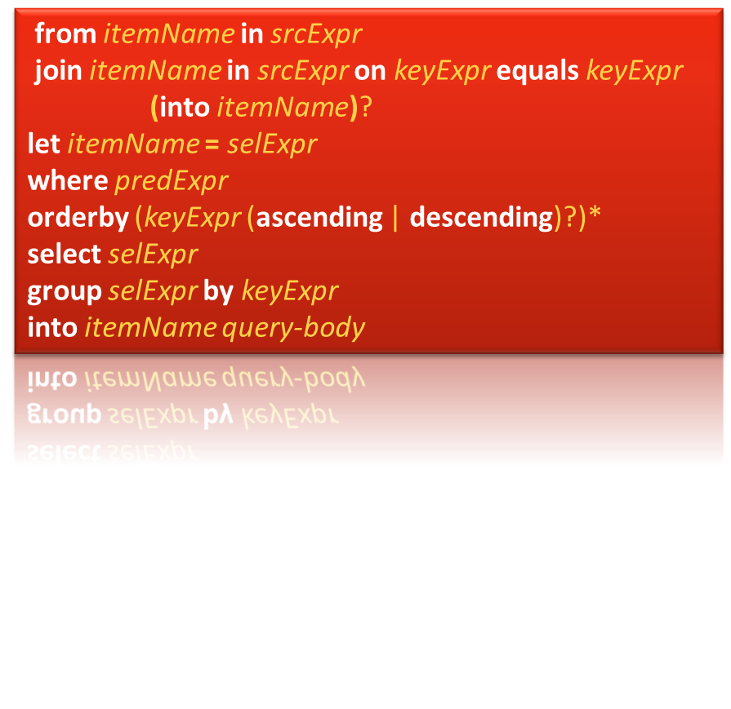


Later today....
<book>
<title/>
<author/>
<price/>
</book>

Slide 46
Summary
LINQ over various sources
  Objects, SQL, XML, other
LINQ builds on other new features
  Type inference, object initialisers, anonymous types, extension methods, lambda expressions
  Enumerable and Queryable from System.Linq
  Query Expressions
Lamdas bound to expression trees

Slide 47
http://www.danielmoth.com/Blog

Slide 48

© 2006 Microsoft Corporation. All rights reserved. Microsoft, Windows, Windows Vista and other product names are or may be registered trademarks and/or trademarks in the U.S. and/or other countries.
The information herein is for informational purposes only and represents the current view of Microsoft Corporation as of the date of this presentation. Because Microsoft must respond to changing market conditions, it should not be interpreted to be a commitment on the part of Microsoft, and Microsoft cannot guarantee the accuracy of any information provided after the date of this presentation.
MICROSOFT MAKES NO WARRANTIES, EXPRESS, IMPLIED OR STATUTORY, AS TO THE INFORMATION IN THIS PRESENTATION.
Notes:
© 2004 Microsoft Corporation. All rights reserved.
This presentation is for informational purposes only. Microsoft makes no warranties, express or implied, in this summary.

